Slide 1

Reverse Engineering
INDIAN SCHOOL OF ETHICAL HACKING(ISOEH) PRESENTS:-
Malware/virus analysis and software cracking/patching…..
www.isoeh.com
www.facebook.com/isoeh.in

Slide 2
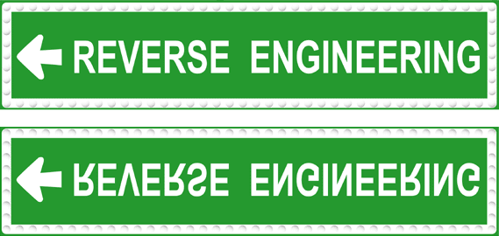
What is Reverse Engineering ?
  Obtain source code of any application/software
  Decipher algorithms from exes, identify design construct and loopholes.
  Retrive source and origins of software for advanced analysis and documentation

Slide 3


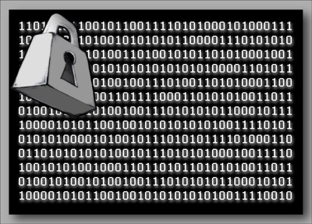
  Applications of RE:
    Security Auditing/Vulnerability Research
    Virus /malware analysis
    Software copy-protection removal (cracking)
    Analyzing binary executables for modifications and comparisons
    Cryptography and Encryption Research

Slide 4
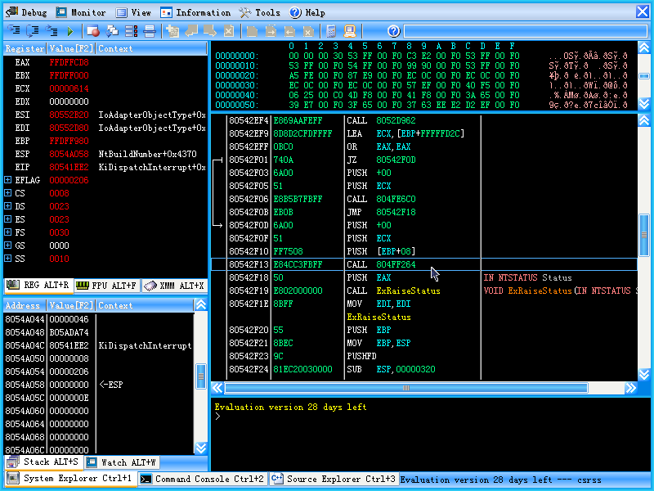
Reversing based on OS and application
There are two broad types:-
  1) User level debugging in RE
  2) Kernel level debugging in RE

Slide 5
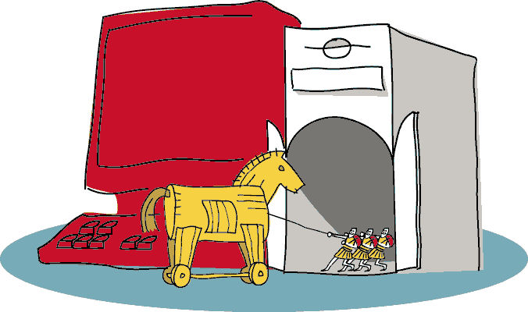
Introduction to Malware
How?
Forms of Malware
Detection Techniques

Slide 6
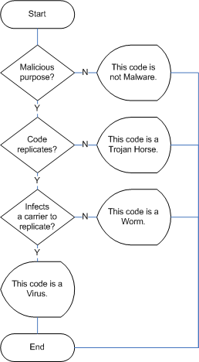
Forms of Malware
Virus
Trojans
Worms
Spyware
Adware

Slide 7

Detection Techniques
Integrity Checking
Static Anti-Virus (AV) Scanners
  Signature-based
    Strings
    Regular expressions
  Static behavior analyzer
Dynamic Anti-Virus Scanners
  Behavior Monitors

Slide 8
Lab Scenario
Static Analysis
  BinText
    Extracts strings from code
  IDA Pro
    Dissembler
    USD 399/user
  UPX
    UPX compression/decompression

Slide 9
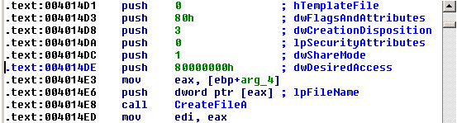
IDA Pro
Disassembles executables into assembly instructions
Easy-to-use interface
  Separates subroutines, creates variable names, color-coded

Slide 10
UPX Decompression
Executable packer commonly used by virus writers
Can compress wide range of files
  Windows PE executables, DOS executables, DOS COM files, and many more
To unpack:
  upx.exe -d -o dest.exe source.exe

Slide 11
Process Observation Tools
Process Explorer
  Monitor processes
FileMon
  Monitor file operations
RegMon
  Monitor operations on registry
Regshot
  Take snapshot of registry and files
ProcDump
  Dump code from memory

Slide 12
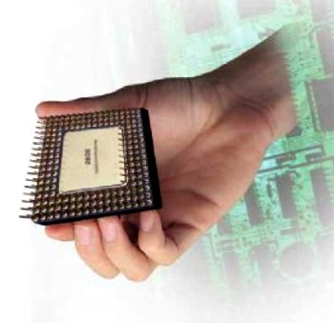
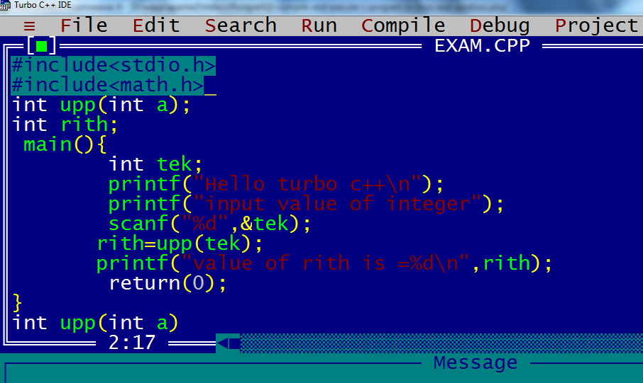
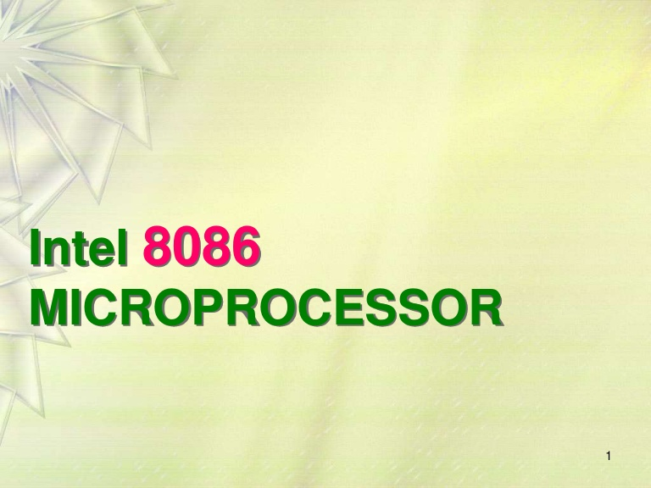
Pre-requisites for Reversing
Knowledge of Intel 8085/86 architecture
Insight into assembly language
Depth concepts on OS , Networking for indepth packet analysis and introspection
C programming

Slide 13
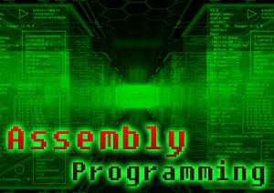
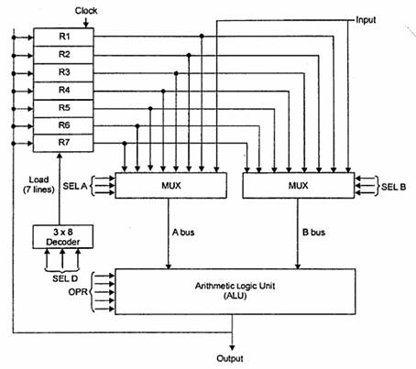
A little assembly walkthrough
Registers
Registers are small chunks of internal memory that reside within the processor and can be accessed very easily, typically with no performance penalty whatsoever.

Slide 14
The CPU’s registers
The Intel 32-bit x86 registers:
EAX
ESP
accumulator
stack pointer
EBX
EBP
base
base pointer
ECX
ESI
counter
source index
EDX
EDI
data
destination index
EIP
instruction pointer
Notes:
The Intel x86 register set has four general purpose registers (EAX, EBX, ECX, EDX) and four pointer registers (ESP, EBP, ESI, EDI). The most important, and the most sought after register is EIP - the Program Counter.
EIP points to memory which contains code. The CPU will fetch the next instruction from memory pointed to by EIP and execute it. If we can make EIP point to arbitrary addresses, which may contain code that we inject, we can take control of an executing process.
The general purpose registers EAX, EBX, ECX and EDX are the Accumulator, Base, Counter and Data registers. They are used for general purpose operations such as arithmetic operations, loops (where ECX gets used as a counter) and condition evaluation.
The two pointer registers ESI and EDI point to blocks of memory, one of them being a source, and one being a destination. There are instructions in the x86 CPU to copy bytes and words from the source location to the destination location. Calls such as memcpy() use these registers.
The Stack Pointer register ESP always points to the top of the stack. A Push operation into the stack causes the stack pointer to decrement, in multiples of 4 bytes, with the pushed value being added on the top of the stack. A Pop operation causes a value to be “lifted off” the stack, and the stack pointer increments in multiples of 4 bytes.

Slide 15
Disassemblers:
Programs that take a program’s executable binary as input and generate textual files that contain the assembly language code
Debuggers:
Debugger is a program that allows software developers to observe their program while it is running.
The two most basic features in a debugger:
  1) Set breakpoints 2)Ability to trace through code.

Slide 16
Decompilers:
A decompiler takes an executable binary file and attempts to produce readable high-level language code from it.
The idea is to try and reverse the compilation process, to obtain the original source file or something similar to it

Slide 17

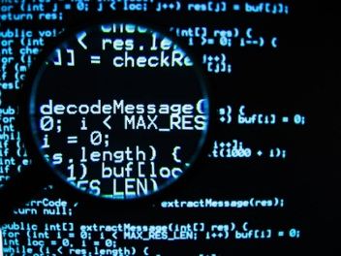
Questions ?
    Time for action….live software cracking

